Slide 1

TEAM 41
Predicting Song Popularity
Notes:
Good afternoon judges! We are Team 41 and we will be presenting our results on the given problem statement which is based on the theme of predicting the popularity of music tracks

Slide 2






Exploratory
Data Analysis
AGENDA
Feature Engineering
Classification Models
Revenue Constraint
Voting
Predictions
Summary
Notes:
To walk you through our findings, we will first take a look at the exploratory data analysis which helped us to get a brief idea of the dataset, followed by feature extraction, where we used our results and intuitions from the EDA to create new features. Next, we will discuss about the classification models that we implemented on our data to get the predictions and then the revenue constraints for our models. Finally, we take a look at the predictions made by ensemble models and how it improved the overall results. Soo, let’s begin with the exploratory data analysis!

Slide 3











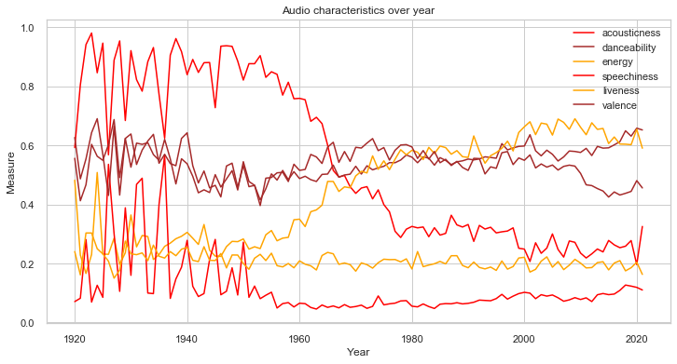

Understanding the Data & Problem Statement
Exploratory
Data Analysis
Music belonging
5 categories
Audio Characteristics
(features)
Developing
forecasting model
Bidding on music track
Maximizing revenue
Feature Engineering
Trends of a few audio characteristics
Insights
Some characteristics like Acousticness and Loudness have clearly visible trends
Some other characteristics remain more or less static over time
Classification Models
Revenue Constraint
Notes:
Our task is to predict the popularity of music tracks into 5 different classes of popularity from very high to very low based on the given audio features. Accordingly, bid will be placed on them so that the revenue is maximum.
The stepwise summary has also been shown in this slide.
From the graph below, we get an idea of the variance of the features with time. As we can see, Some features like Accoucticness and loudness have significant linear trends while some others have remained more or less static over time.

Slide 4
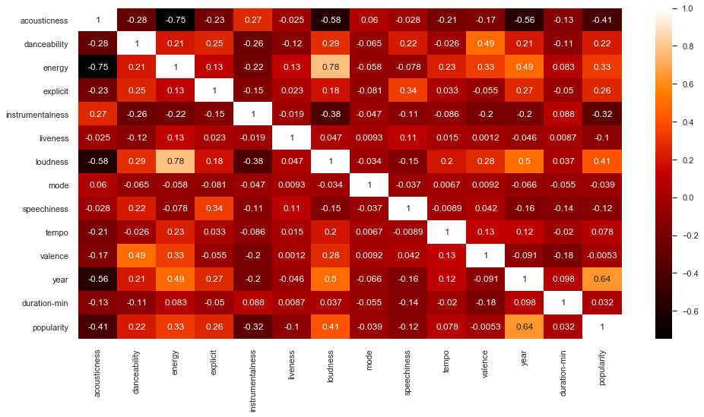


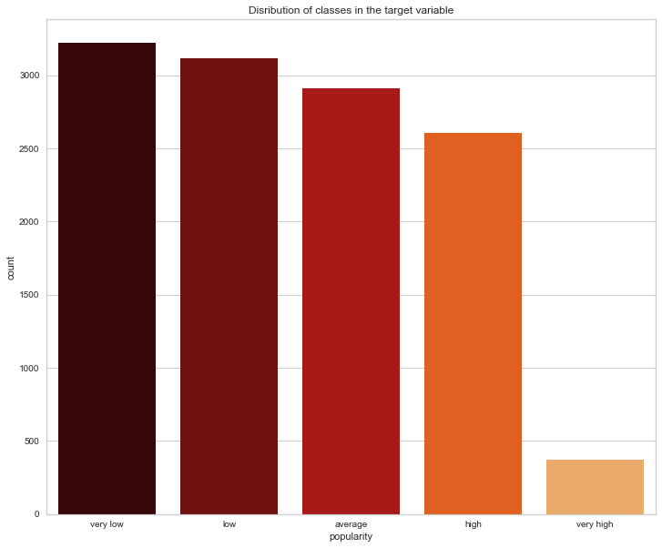
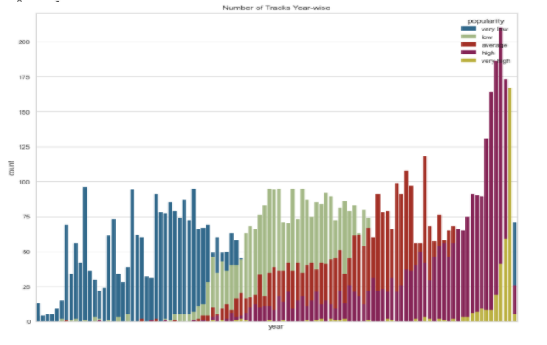
DATA VISUALISATION AND INSIGHTS
Heat Map
Our Insights
Exploratory
Data Analysis
Feature Engineering
1) Trend shifting towards higher popularity with time
Imbalance Class Classification
Time Trends
Classification Models
2) Year, loudness and accousticness have maximum correlation with target variable
Revenue Constraint
Notes:
Let us first see some key observations from exploratory data analysis
Here we see heat map correlation. We observe that Year, loudness and accousticness have maximum correlation with target variable i.e popularity
From the next graph we can see, that data is imbalance, the class “very high” constitutes a very low percentage of songs
In the next graph we see that the trend for popularity with time which is gradually shifting towards high.

Slide 5

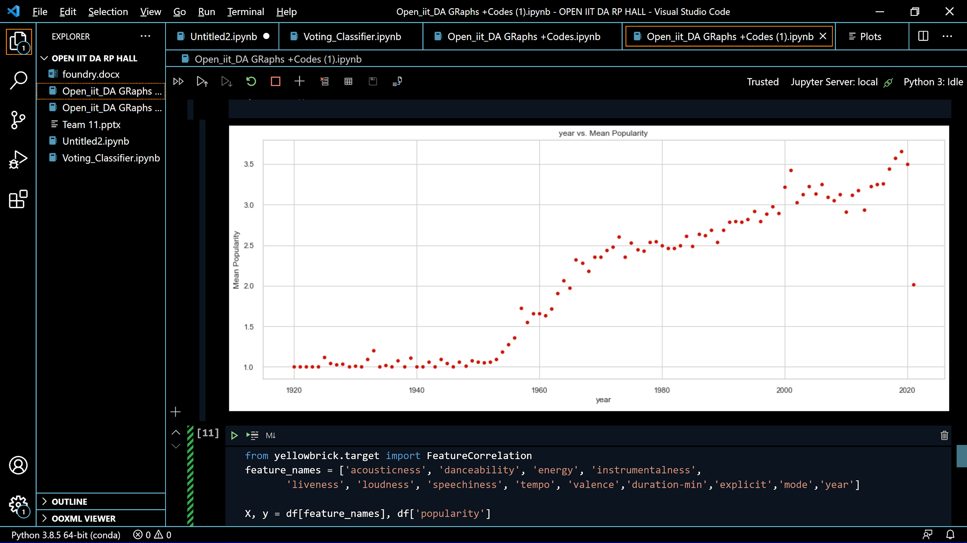
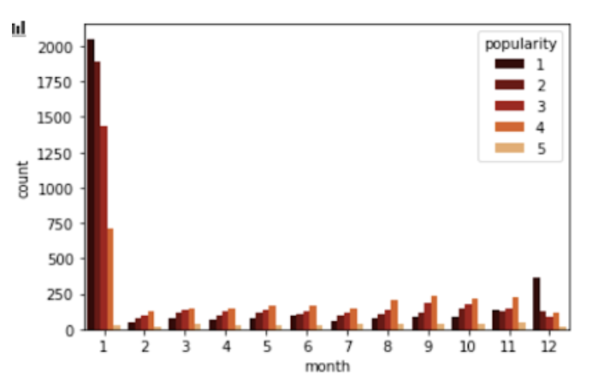
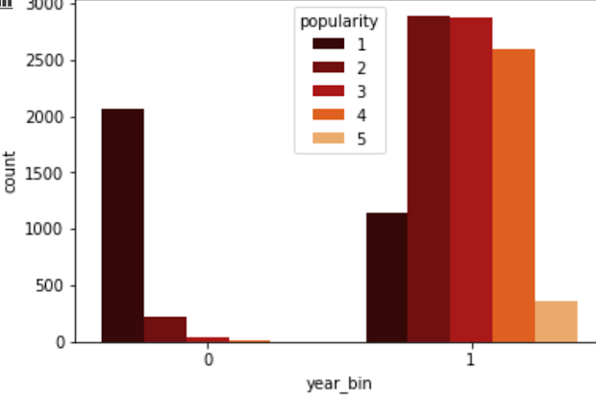
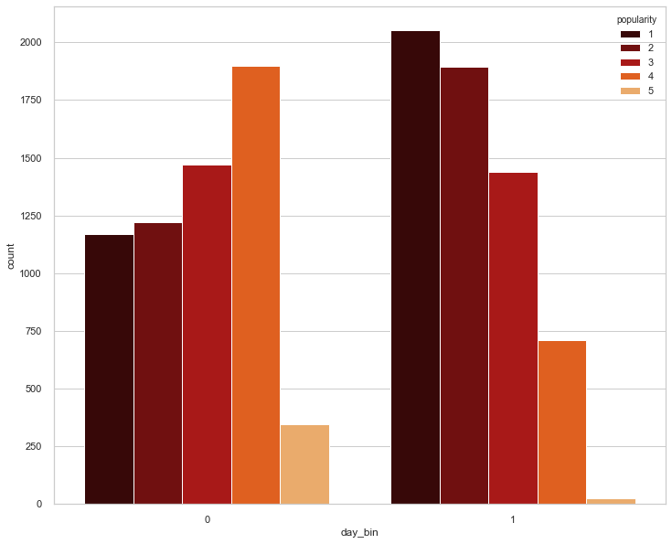
Intuition Behind Feature Engineering
Year Bin
Month Bin
Exploratory
Data Analysis
Feature Engineering
Very low popularity till 1960 and clear upward trend after that.
1 represents songs released post 1960 and 0 represents those before 1960
Large proportion of songs released in January.
1 represents songs released in January while 0 represents those released in other months.
Classification Models
Revenue Constraint
Notes:
Feature engineering is one the important steps in data analytics, This is where actual creativity comes in and also significantly affects the model performance.
We have created 3 new features .Lets talk about them one by one .
As clear from the graph on the left side, the songs released before 1960 have very low popularity and after that there is a continuous upward trend . So, we have created a feature named year_bin,where 1 represents post 1960 songs and 0 represents songs released in 1960 or earlier.
Similarly, we have observed that most of the songs were released during January and have a different popularity distribution than the rest.
In our new feature "Month_bin", 1 represents songs released in January while 0 represents those released in other months.

Slide 6

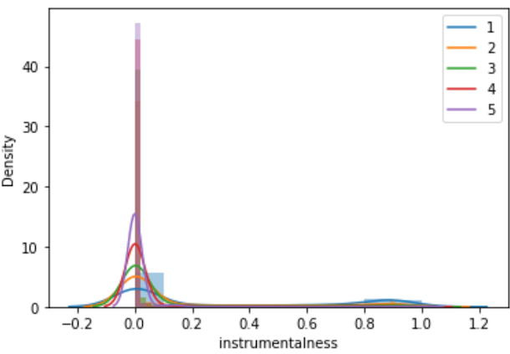
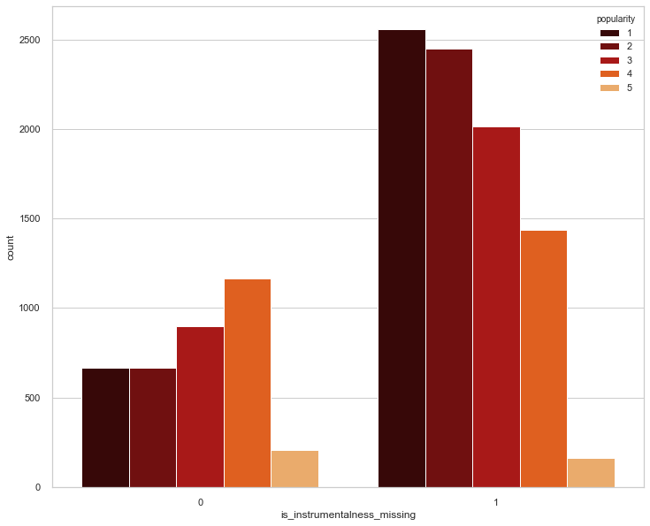
Intuition Behind Feature Engineering
Instrumentalness Bins
Exploratory
Data Analysis
Feature Engineering
Classification Models
Around 30% of data samples have instrumentalness value as 0. This abnormality can be seen clearly in the left graph.
1 represents non-zero values and 0 represents others.
The two bins of the transformed features have clearly different class-wise distributions of popularity thus adding more discriminative power which led to better model performance.
Revenue Constraint
Notes:
We have added one more feature called is_instrumentalness.
On performing EDA on instrumentalness, around 30% data samples were found to have value 0. This causes some abnormality which can be seen in the left graph. In the right graph which is our new feature, 1 represents non-zero values, 0 represents others.
The two bins of the transformed features have clearly different class-wise distributions of popularity thus adding more discriminative power, giving us a better model performance.
As we will find out later, all these new features have helped to improve the performance of our model

Slide 7
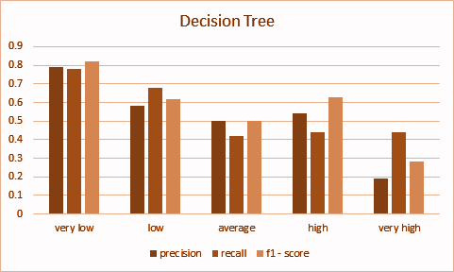



Decision Trees
Feature Engineering
Decision tree is a predictive model which uses a tree based algorithm. The decision trees
are built by splitting the set source, constituting the root node of the tree, into
subsets—which constitute the successor children.
Classification Models
Why Decision Trees?
Results
Disjunctive hypothesis space
Revenue Constraint
Works well with noisy data
Voting Predictions
Notes:
We start about classification models with decision trees also known as D-Trees
----------------------------1.Decision Trees-------------------------
->Decision tree is a predictive model which uses a tree based algorithm..The D-trees
are built by splitting the source set, constituting the root node of the tree, into
subsets—which constitute the successor children.
----The two reasons to use D-Trees are as follows:
->>D-trees have a powerful representation and are one of the best performers on a
large, disjunctive hypothesis space.
->>They also work well when the data is noisy
These reasons make D-Trees a sensible choice as a starting model
Here in the graph we can see the result of D-Trees :

Slide 8
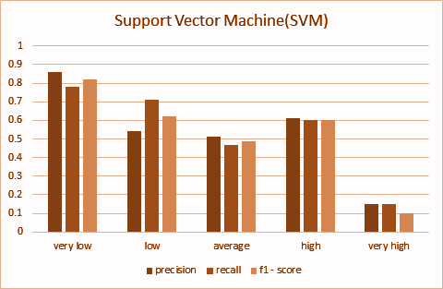


Support Vector Classifier
Feature Engineering
Support Vector Classifier is a supervised classification algorithm in which each data item is plotted as a point in n-dimensional space (where n is the number of features) with the
value of each feature being the value of a particular coordinate.
Classification Models
Why SVC ?
Results
Captures
complex data
Revenue Constraint
Transforms Data into higher dimension
Voting Predictions
Notes:
Next we had used
---------------------------- 2. Support Vector Classifier -------------------------
->Support Vector Classifier is a supervised classification algorithm in which each data item
is plotted as a point in n-dimensional space (where n is the number of features) with the
value of each feature being the value of a particular coordinate.
----The two reasons to use SVM are as follows:
->>Non-linear SVM provides the benefit of capturing much more complex relationships
between the data points without having to perform difficult transformations on our own.
->>We have used our kernel as the Radial Basis Function for this purpose. This algorithm is
accurate yet less prone to overfitting.
Here in the graph we can see the result of SVC we got :

Slide 9

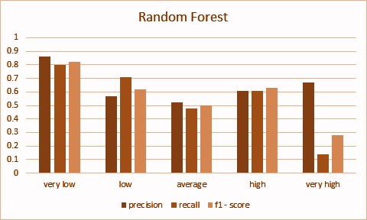

Random Forest Classifier
Feature Engineering
Random forest is a bagging model which consists of a large number of individual
decision trees generated parallely which are the base learners and operate as an ensemble.
Classification Models
Why Random Forest?
Results
Independent Trees
Revenue Constraint
Improves accuracy, reduces variance
Voting Predictions
Notes:
Next we come to
----------------------------3. Random Forest-------------------------
->Random forest is a bagging model which consists of a large number of individual
decision trees generated parallely, which are the base learners and operate as an ensemble.
----The reason why we used SVC is:
->>Being a bagging model, random forest allows each individual tree to randomly sample
from the dataset with replacement, resulting in different trees trained on different sets of
data as well as different subset of features. Thus, independent trees are grown, which help
to simultaneously improve accuracy and reduce variance (and thus overfitting)
Here in the graph we can see the result of random forest:

Slide 10
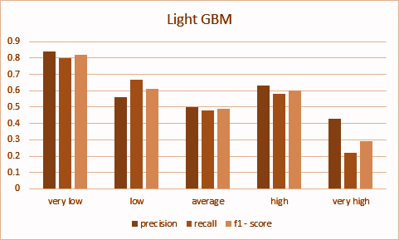


Light GBM
Feature Engineering
LightGBM is a fast, distributed, high-performance gradient boosting framework that uses
tree based learning algorithms that splits the tree leaf wise with the best fit.
Classification Models
Why Light GBM?
Results
Efficient and less memory
Revenue Constraint
Histogram based decision tree learning algorithm
Voting Predictions
Notes:
Next we arrive at
----------------------------4. Light GBM-------------------------
->LightGBM is a fast, distributed, high-performance gradient boosting framework that uses
tree based learning algorithms that splits the tree, leaf wise with the best fit.
----The reason for using Light GBM is:
->>It implements a highly optimized histogram-based decision tree learning algorithm, which yields great
advantages on both efficiency and memory consumption.
Here in the graph we can see the result of light GBM:

Slide 11
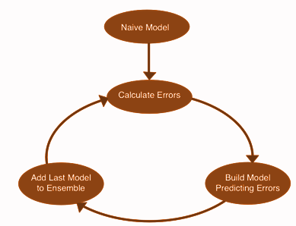
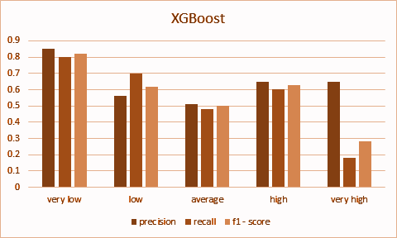


XGBoost
XGBoost is an optimized distributed gradient boosting library designed to be highly efficient, flexible and portable. It implements machine learning algorithms under the Gradient Boosting framework.
Feature Engineering
Classification Models
Why XGBoost?
Results
Model Performance
Revenue Constraint
Execution Speed
Voting Predictions
Notes:
Next we come to XGBoost also known as extreme gradient boosting
----------------------------5. XGBOost-------------------------
->XGBoost is an optimized distributed gradient boosting library designed to be highly efficient, flexible and portable. It implements machine learning algorithms under the Gradient Boosting framework.
----The two reasons to use XGBoost are as follows:
->> It is really fast when compared to other implementations of gradient
boosting.
->> It dominates structured datasets on classification
problems.
Here in the graph we can see the result of XGBoost :

Slide 12
Revenue Constraint
Feature Engineering
Considering 80/20 split, for a particular validation set a perfect prediction would require us to bid a total of $7,341 units suitably.
We can bid a total of $10,000 units on 4,000 songs. Taking into account this 2.5 multiplier factor and our validation set having 2446 observations, we get a threshold of $6115 (2446*2.5), which is around 83% of the total required money.
Thus, inherently, we can't get a very high accuracy. Because of the same reason, it's impossible to get the max revenue with that amount which is 6115*2 = 12230 (since we get double the revenue on each song as is the bid value).
Also, accuracy isn’t necessarily proportional to revenue because of the threshold and bidding rules. It’s important to keep in mind the final goal of generating maximum revenue. So, it makes sense to bias the model toward the higher popularity classes in return of compromising with the accuracy.
Classification Models
Revenue Constraint
Voting Predictions

Slide 13
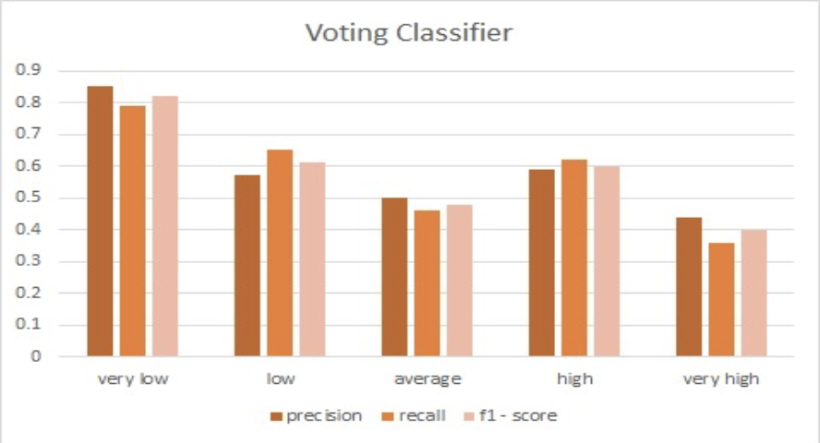

Voting Predictions
Classification Models
Model 1
Prediction 1
Model 2
Prediction 2
Training Set
Voting
Final Predictions
Model 3
Prediction 3
Revenue Constraint
Model 4
Prediction 4
Model Weights
Final Results on Validation Test
Intentionally biased Random Forest model towards the top 2 classes.
XGBoost excluded because of poor performance.
Given more weight to Random Forest than other model as it gave best result individually.
Results improved, particularly for the minority class.
Voting Predictions
Summary

Slide 14
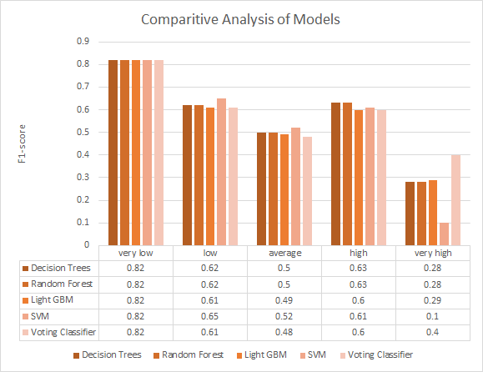
Voting Classifier Predictions v/s Other Models
Classification Models
Revenue Constraint
Voting Predictions
Summary

Slide 15
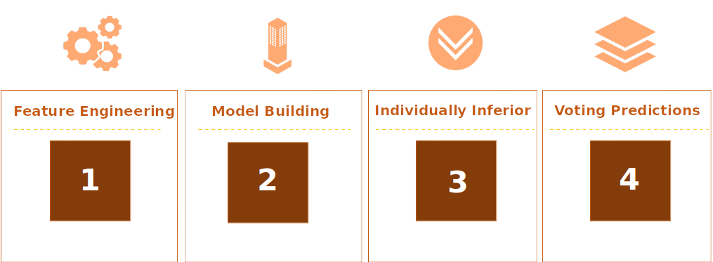
Summary
Classification Models
Revenue Constraint
Voting Predictions
Incorporating new features like Year_bin, Month_bin, etc
Applied classifiers of different types like bagging , boosting etc
No individual model performed well across all 5 categories
Voting Classifier using the different models gave the best result
Summary

Slide 16

THANK YOU

Slide 17
Backup Slides
Dealing imbalance using SMOTE
1
XGB vs LightGBM
2
Gridsearch parameters
3
Intuition behind class_weights for RMF
4

Slide 18
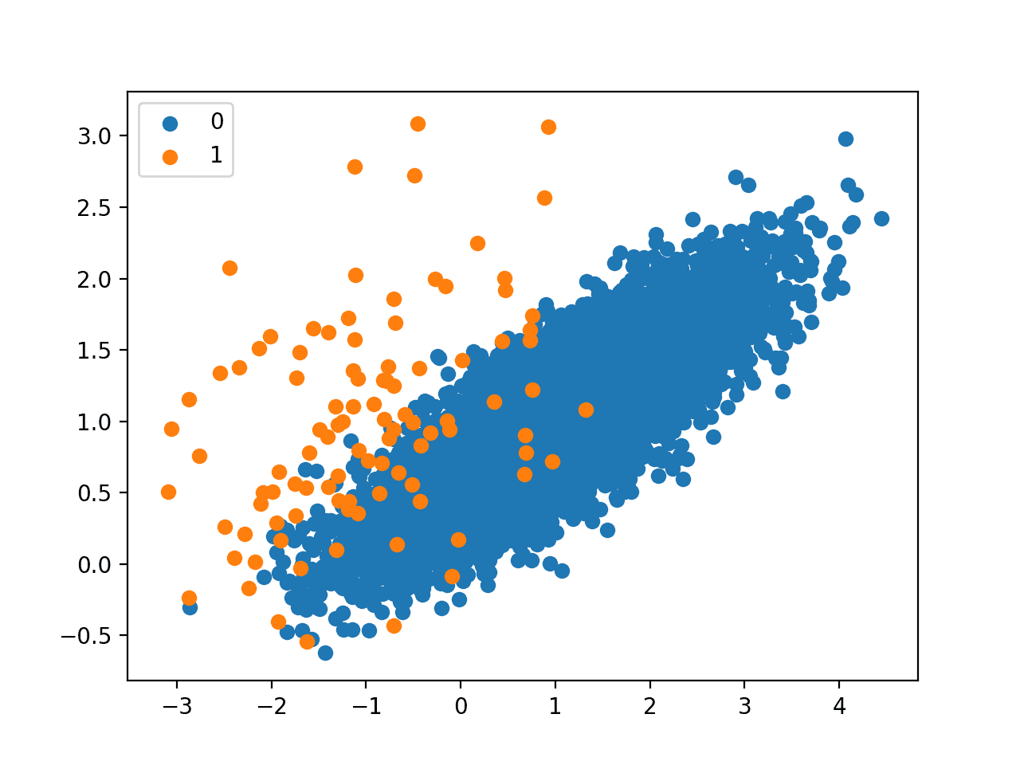
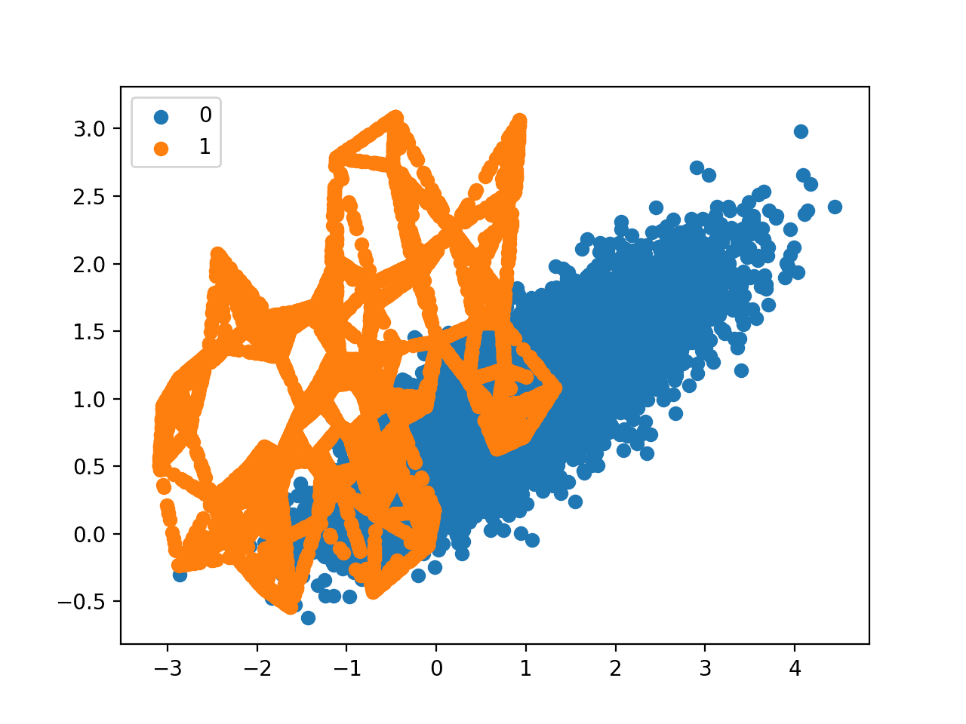
Balancing Dataset using SMOTE
SMOTE (Synthetic Minority Oversampling Technique) is a common method of dealing with the problem of imbalanced classes. It is an oversampling technique where the synthetic samples are generated for the minority class.
This algorithm helps to overcome the overfitting problem posed by random oversampling. It focuses on the feature space to generate new instances with the help of interpolation between the positive instances that lie together.

Slide 19
XGBoost vs LightGBM
XGBoost uses pre-sorted algorithm & Histogram-based algorithm for computing the best split.
XGboost splits up to the specified max_depth hyperparameter and then starts pruning the tree backwards and removes splits beyond which there is no positive gain.
In both LightGBM and XGBoost missing values will be allocated to the side that reduces the loss in each split.
LightGBM uses a novel technique of Gradient-based One-Side Sampling (GOSS) to filter out the data instances for finding a split value.
LightGBM uses leaf-wise (best-first) tree growth. It chooses to grow the leaf that minimizes the loss, allowing a growth of an imbalanced tree.
Histogram-based algorithm splits all the data points for a feature into discrete bins and uses these bins to find the split value of the histogram.

Slide 20
GridSearch Parameters
A machine learning model has multiple parameters that are not trained by the training set. These parameters control the accuracy of the model. These parameters, referred to as the hyperparameters are particularly important in data science projects as they directly influence the model performance. Grid search is a tuning technique that attempts to compute the optimum values of hyperparameters. It is an exhaustive search that is performed on the specific parameter values of a model. The model is also known as an estimator. Here, we present the parameters returned by grid search on the models we have trained:
Estimator | Parameters
Random Forest Classifier | n_estimators=500,min_samples_leaf=5, max_features=sqrt, class_weight = {0:3, 1:3, 2:4, 3:7, 4:38}
Support Vector Classifier | C=100,kernel="rbf",gamma =0.1, probability = True , class_weight={0:4, 1:4, 2:4, 3:5, 4:25}
Light GBM | lambda_l1=1.5, lambda_l2= 0, min_data_in_leaf = 30, num_leaves= 31, reg_alpha=0.1
Decision Trees | ccp_alpha=0.001, criterion = 'entropy', max_depth = 10, max_features = 0.9, min_samples_leaf = 6, min_samples_split = 15

Slide 21
Intuition behind class weights for RMF
A simple technique for modifying a decision tree for imbalanced classification is to change the weight that each class has when calculating the “impurity” score of a chosen split point.
This modification of random forest is referred to as Weighted Random Forest and can be achieved by setting the class_weight argument on the RandomForestClassifier class.
From the confusion matrices, we observed that even after using the ‘balanced’ function, very few observations were being labelled as ‘very high’. This is a concern for us, as these are the songs which will generate highest revenue, this stems originally from the lesser number of “very high” labelled songs in the dataset.
The final chosen weights were: class_weight = {0:4, 1:4, 2:4, 3:7, 4:35}

